Slide 1
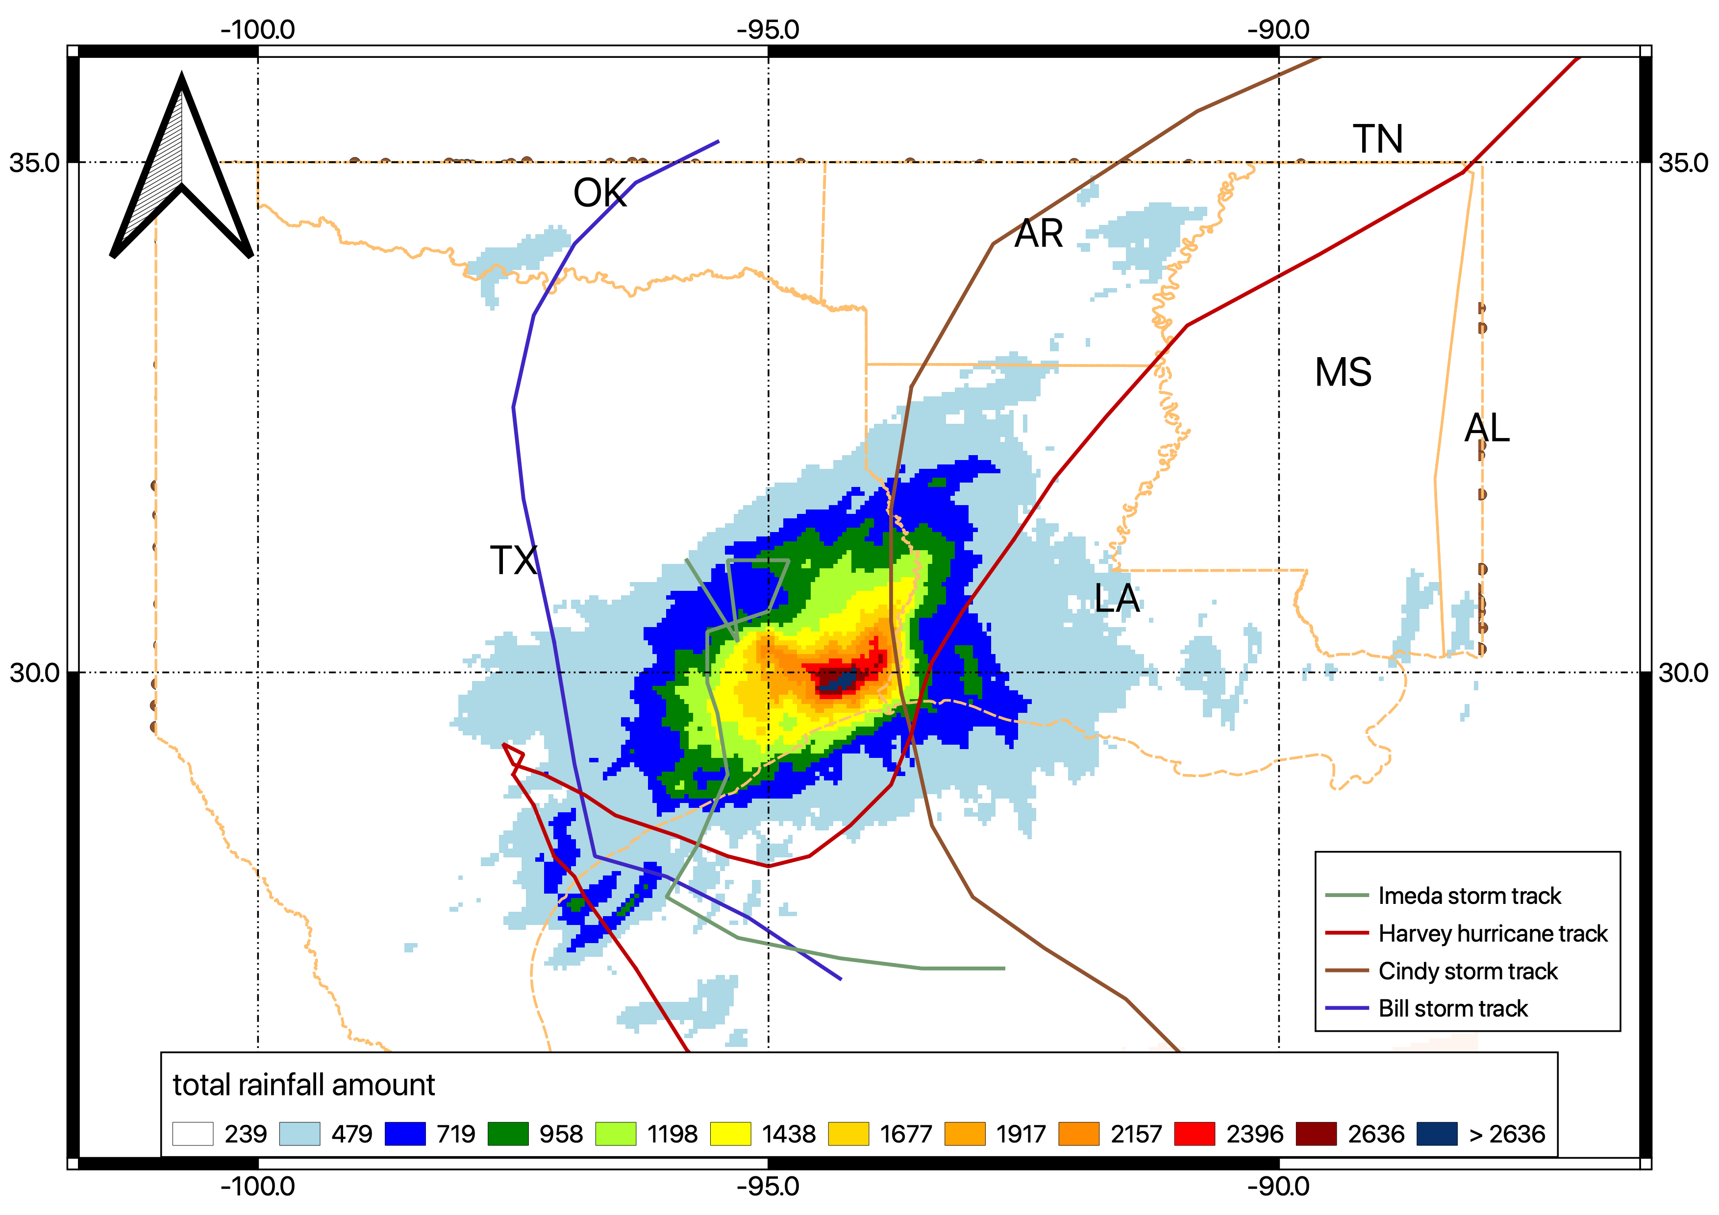
(mm)
Figure 1 Accumulative rainfall for four events combined is measured by MRMS radar data. Four cyclones tracks are illustrated with lines.

Slide 2
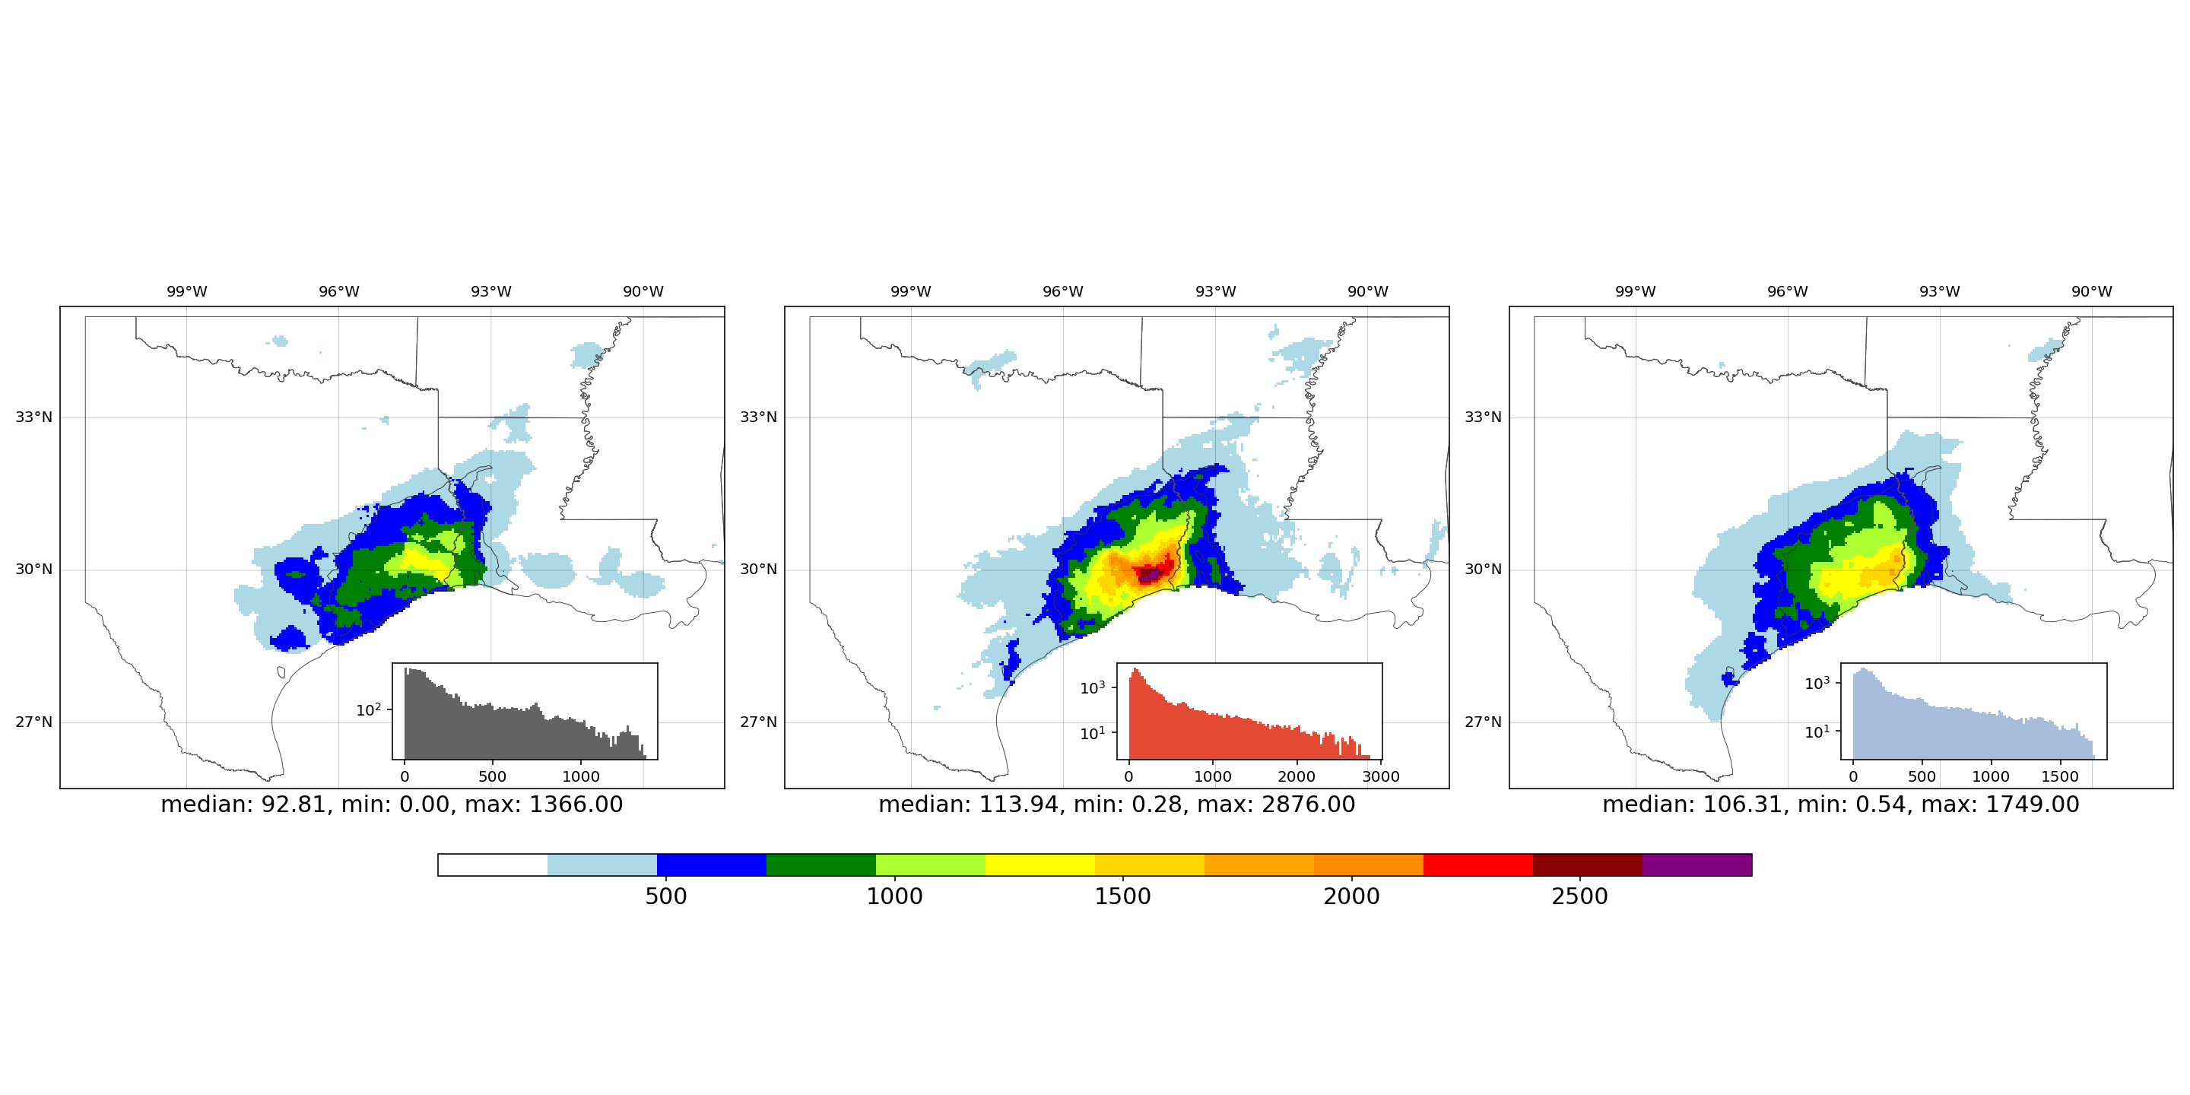
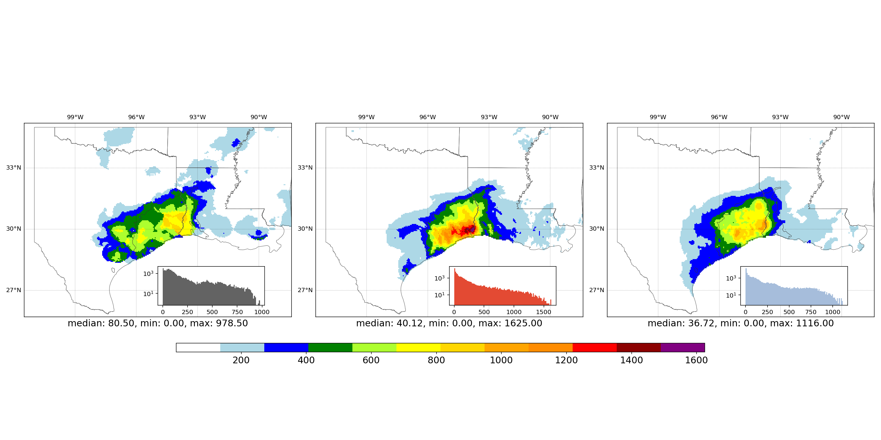
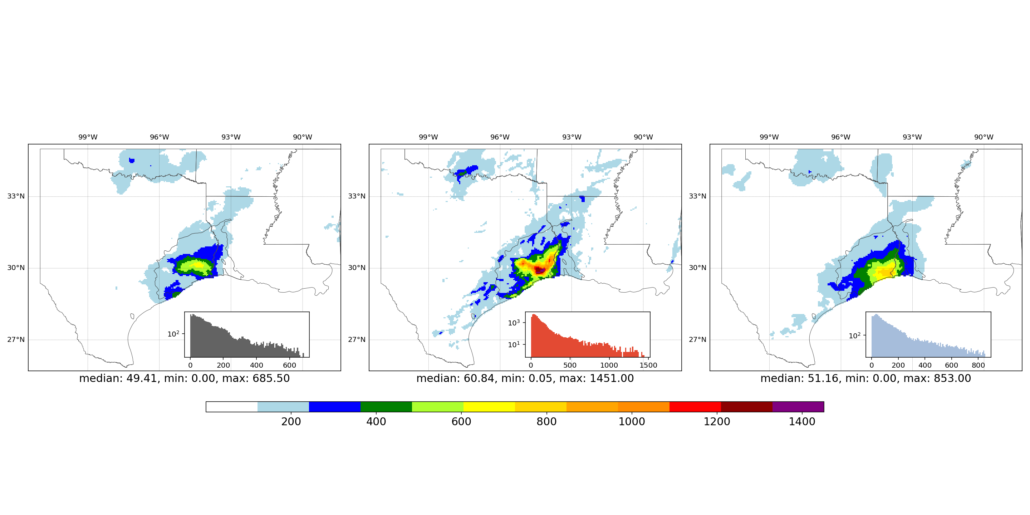
NCEP
MRMS
IMERG
All
Harvey
other
Figure 2 Accumulative rainfall observed by three cases, from top to down: all four events concatenated, Harvey-only case and non-Harvey. Inside each axes, the small pane corresponds to the histogram of accumulative rainfall.

Slide 3
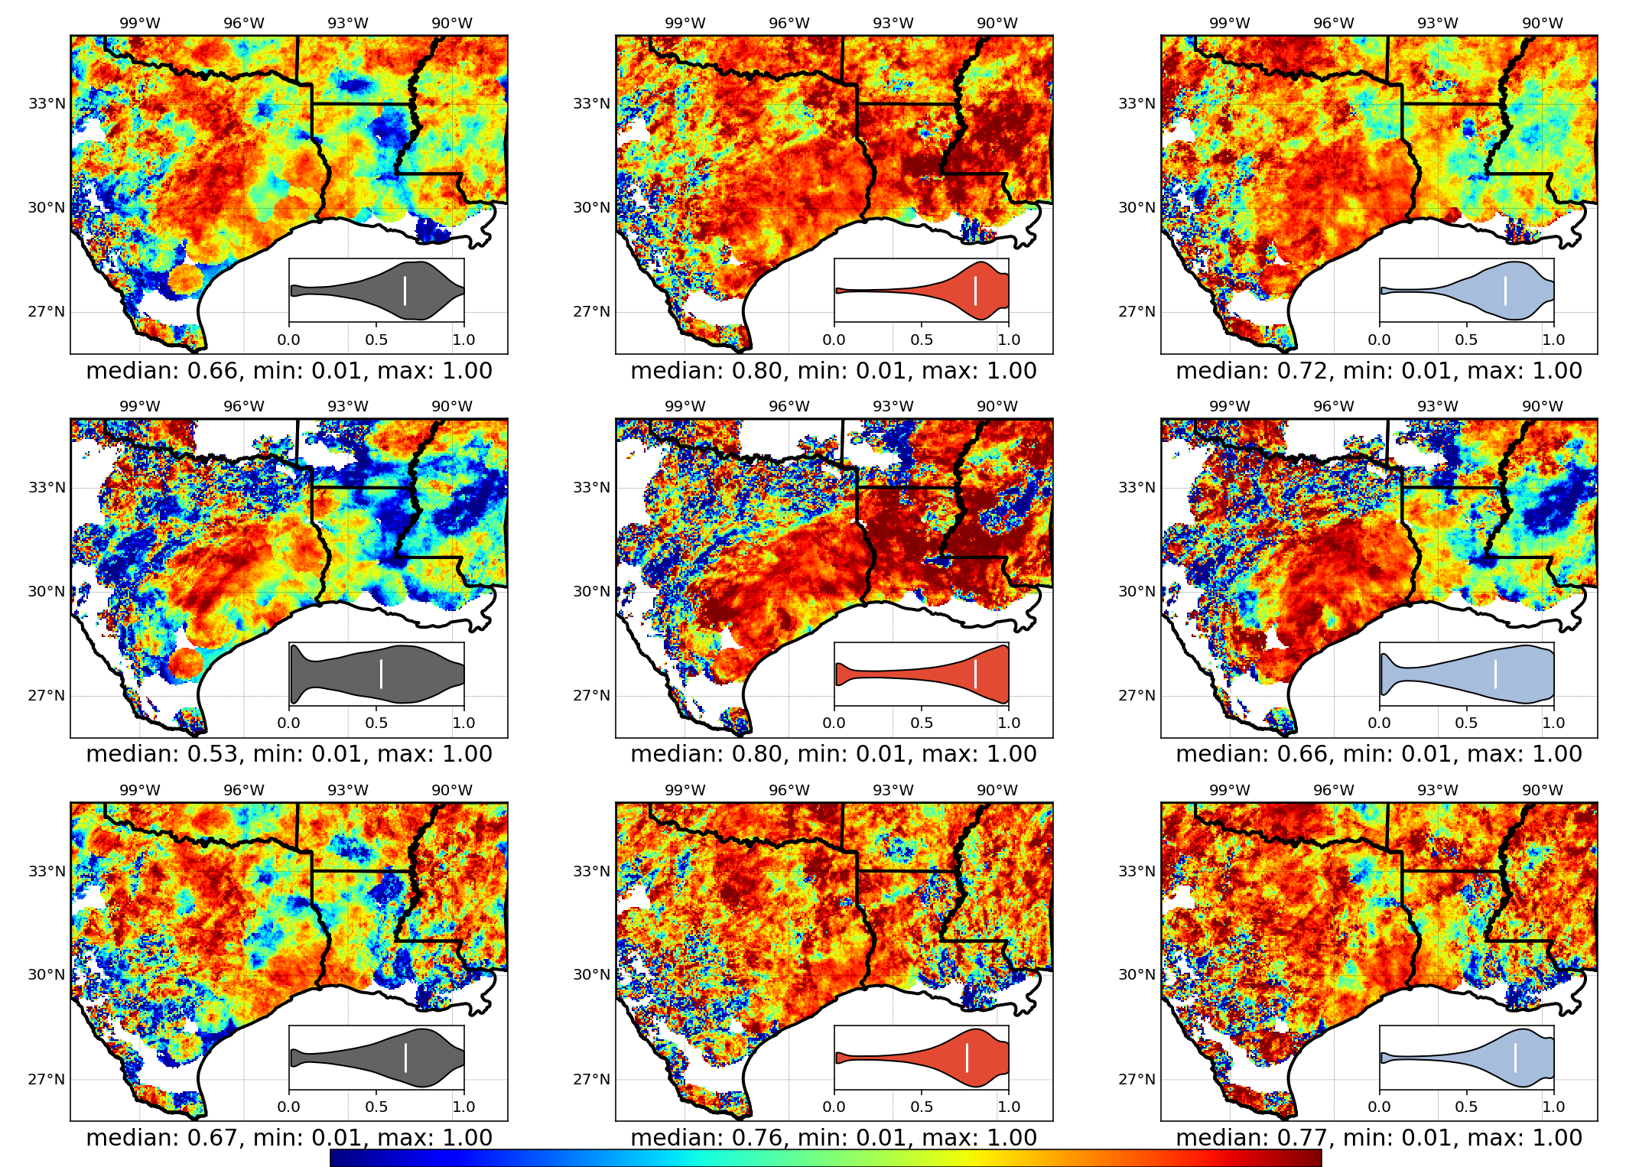
NCEP
MRMS
IMERG
All
Harvey
Other
0.0
1.0
Figure 3 Correlation coefficient extracted using TC method. Three cases (concatenated all events, Harvey-only and non-Harvey) are considered within three rows, and each column represents each product. Small pane inside each axes is the violin plot for the metric and white bar is where median value is located.

Slide 4
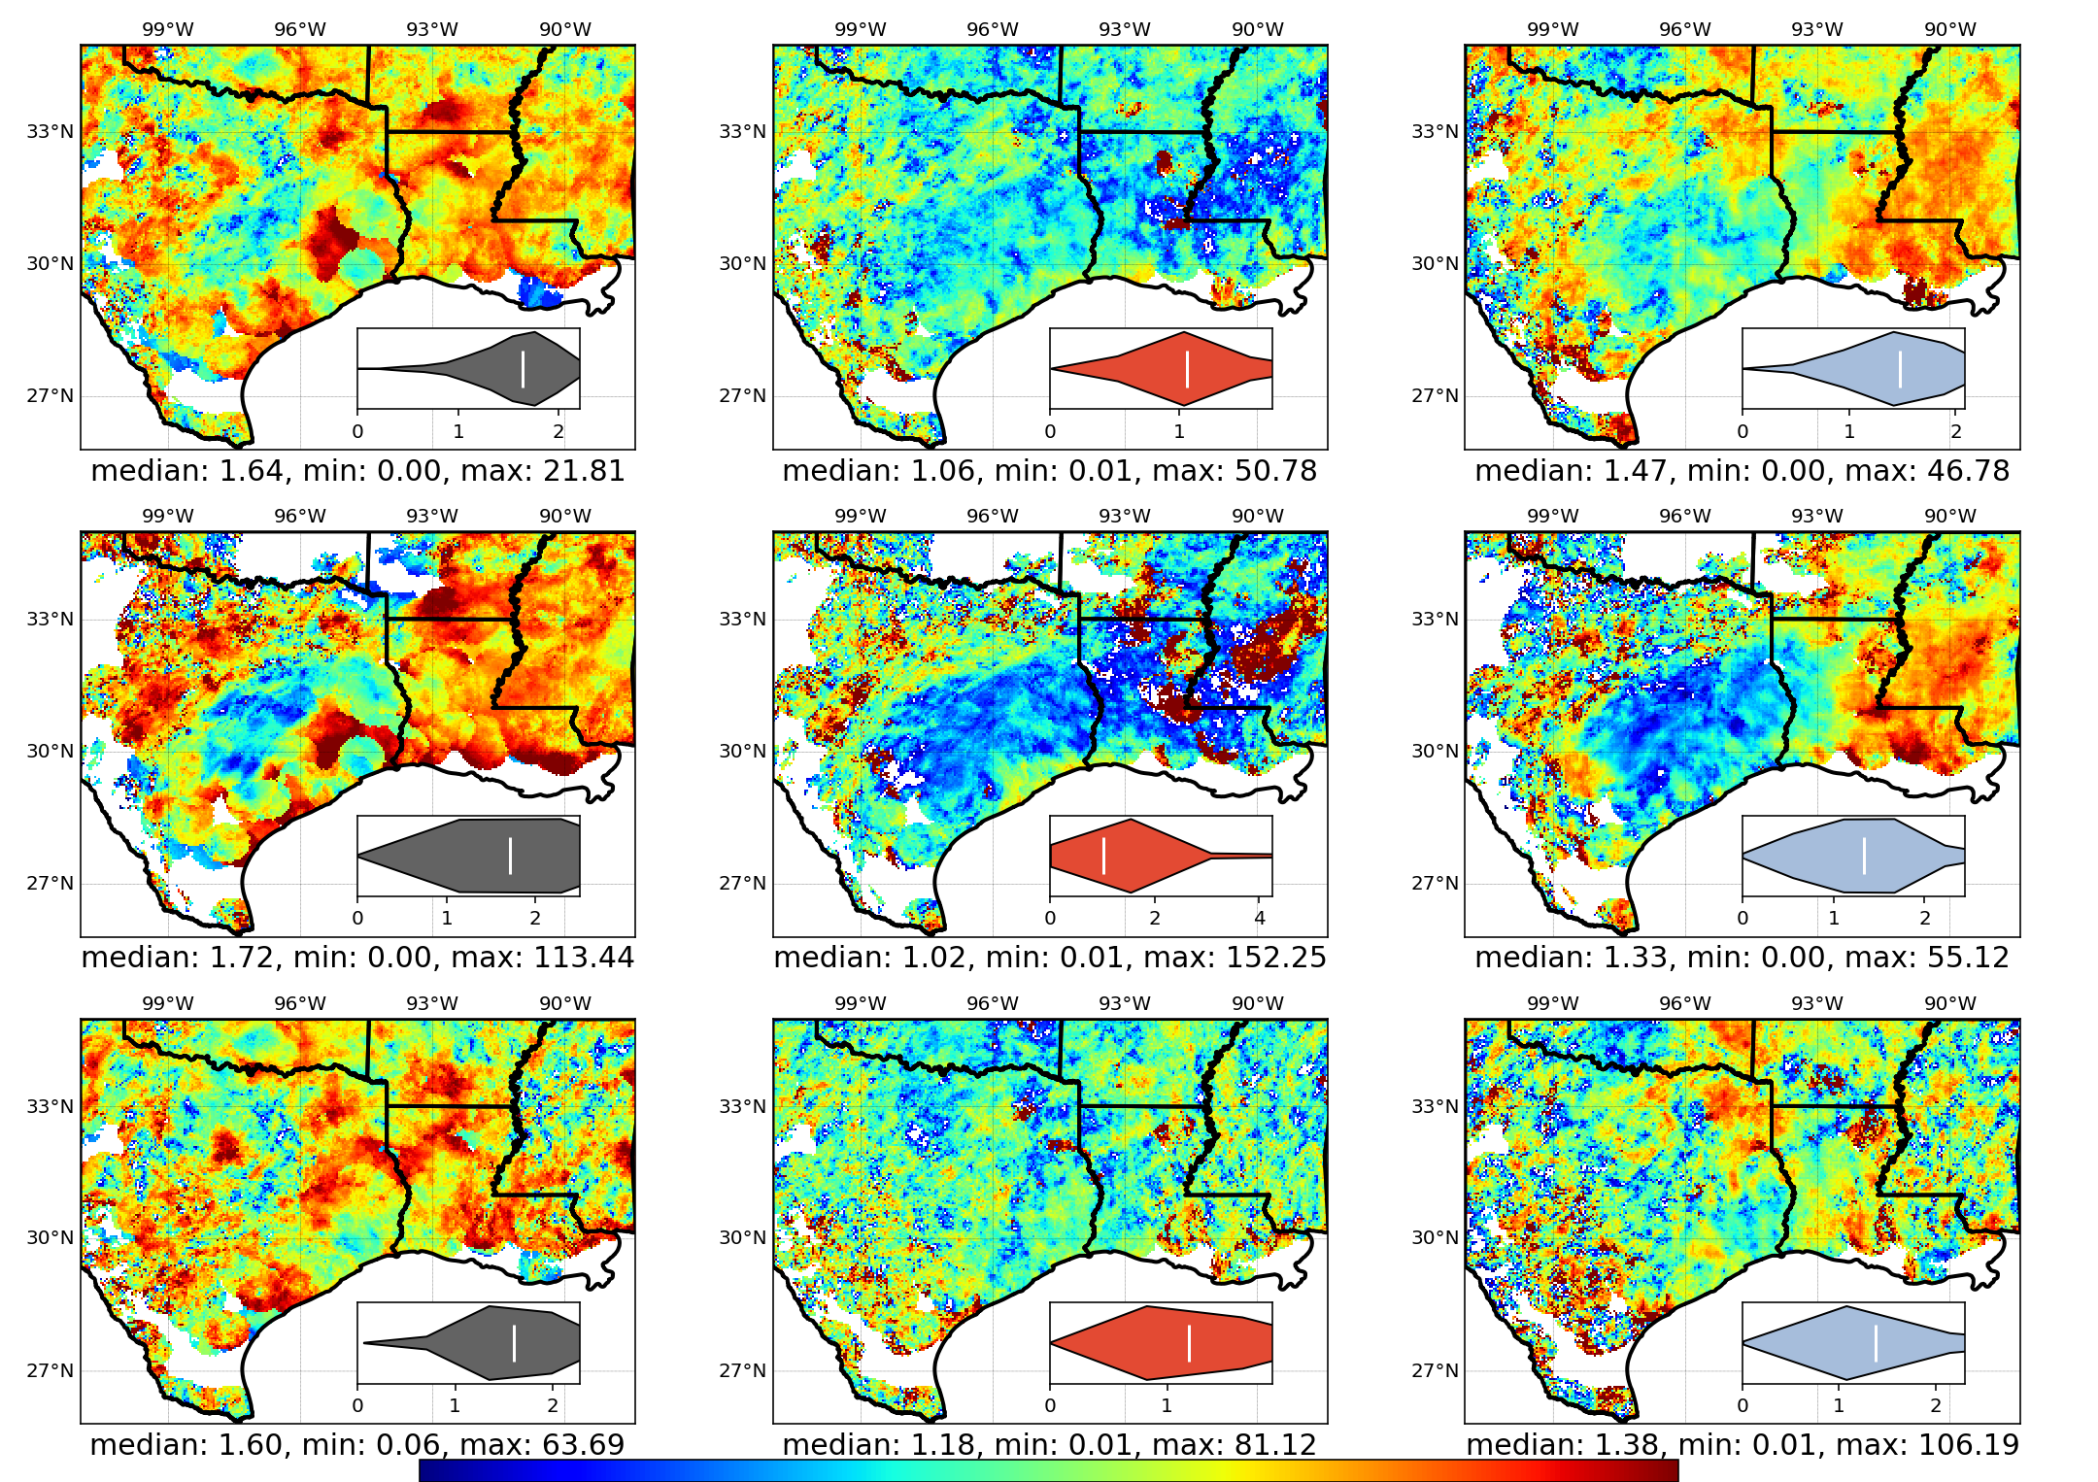
NCEP
MRMS
IMERG
All
Harvey
Other
0.0
2.5 mm/hour
Figure 4 RMSE computed from TC method. Two marked circles indicate the consistent results

Slide 5
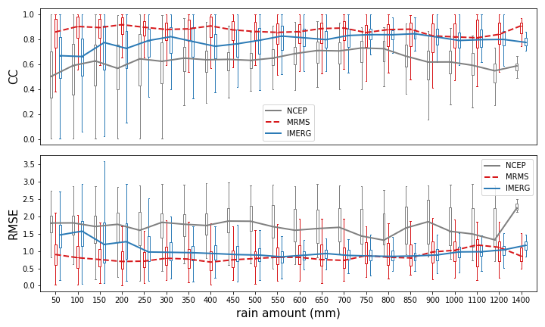
Figure 5 box plot of TC measured CC, RMSE (from top down) at each accumulative rain bins for 50 mm interval w.r.t. MRMS data. The lines connected the median value of each box for corresponding product. To distinguish MRMS product and IMERG product, MRMS is represented with dashed red line.

Slide 6
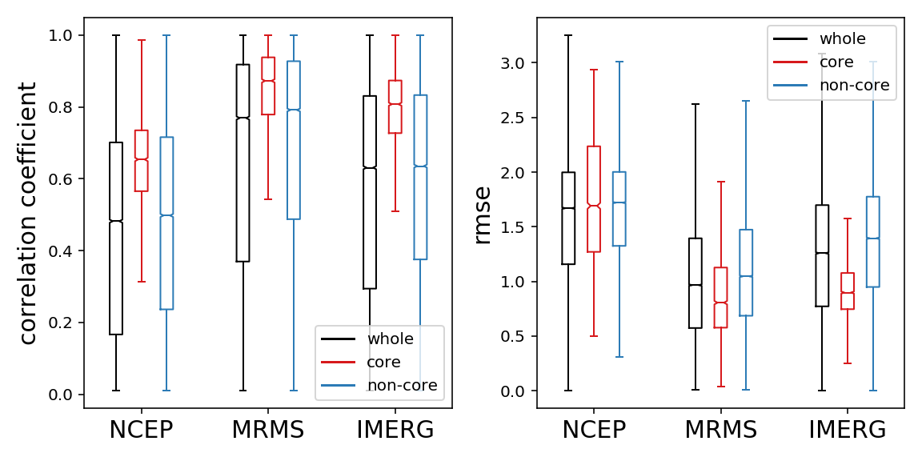
Figure 6 box plot of TC measured CCs and RMSEs for three products grouped by whole, core and non-core regions. Extreme values i.e. outliers (outside of 1st/3rd quartile $∓$ inter-quartile) are ignored to visualize the difference. The notch represents the median value for the samples.

Slide 7
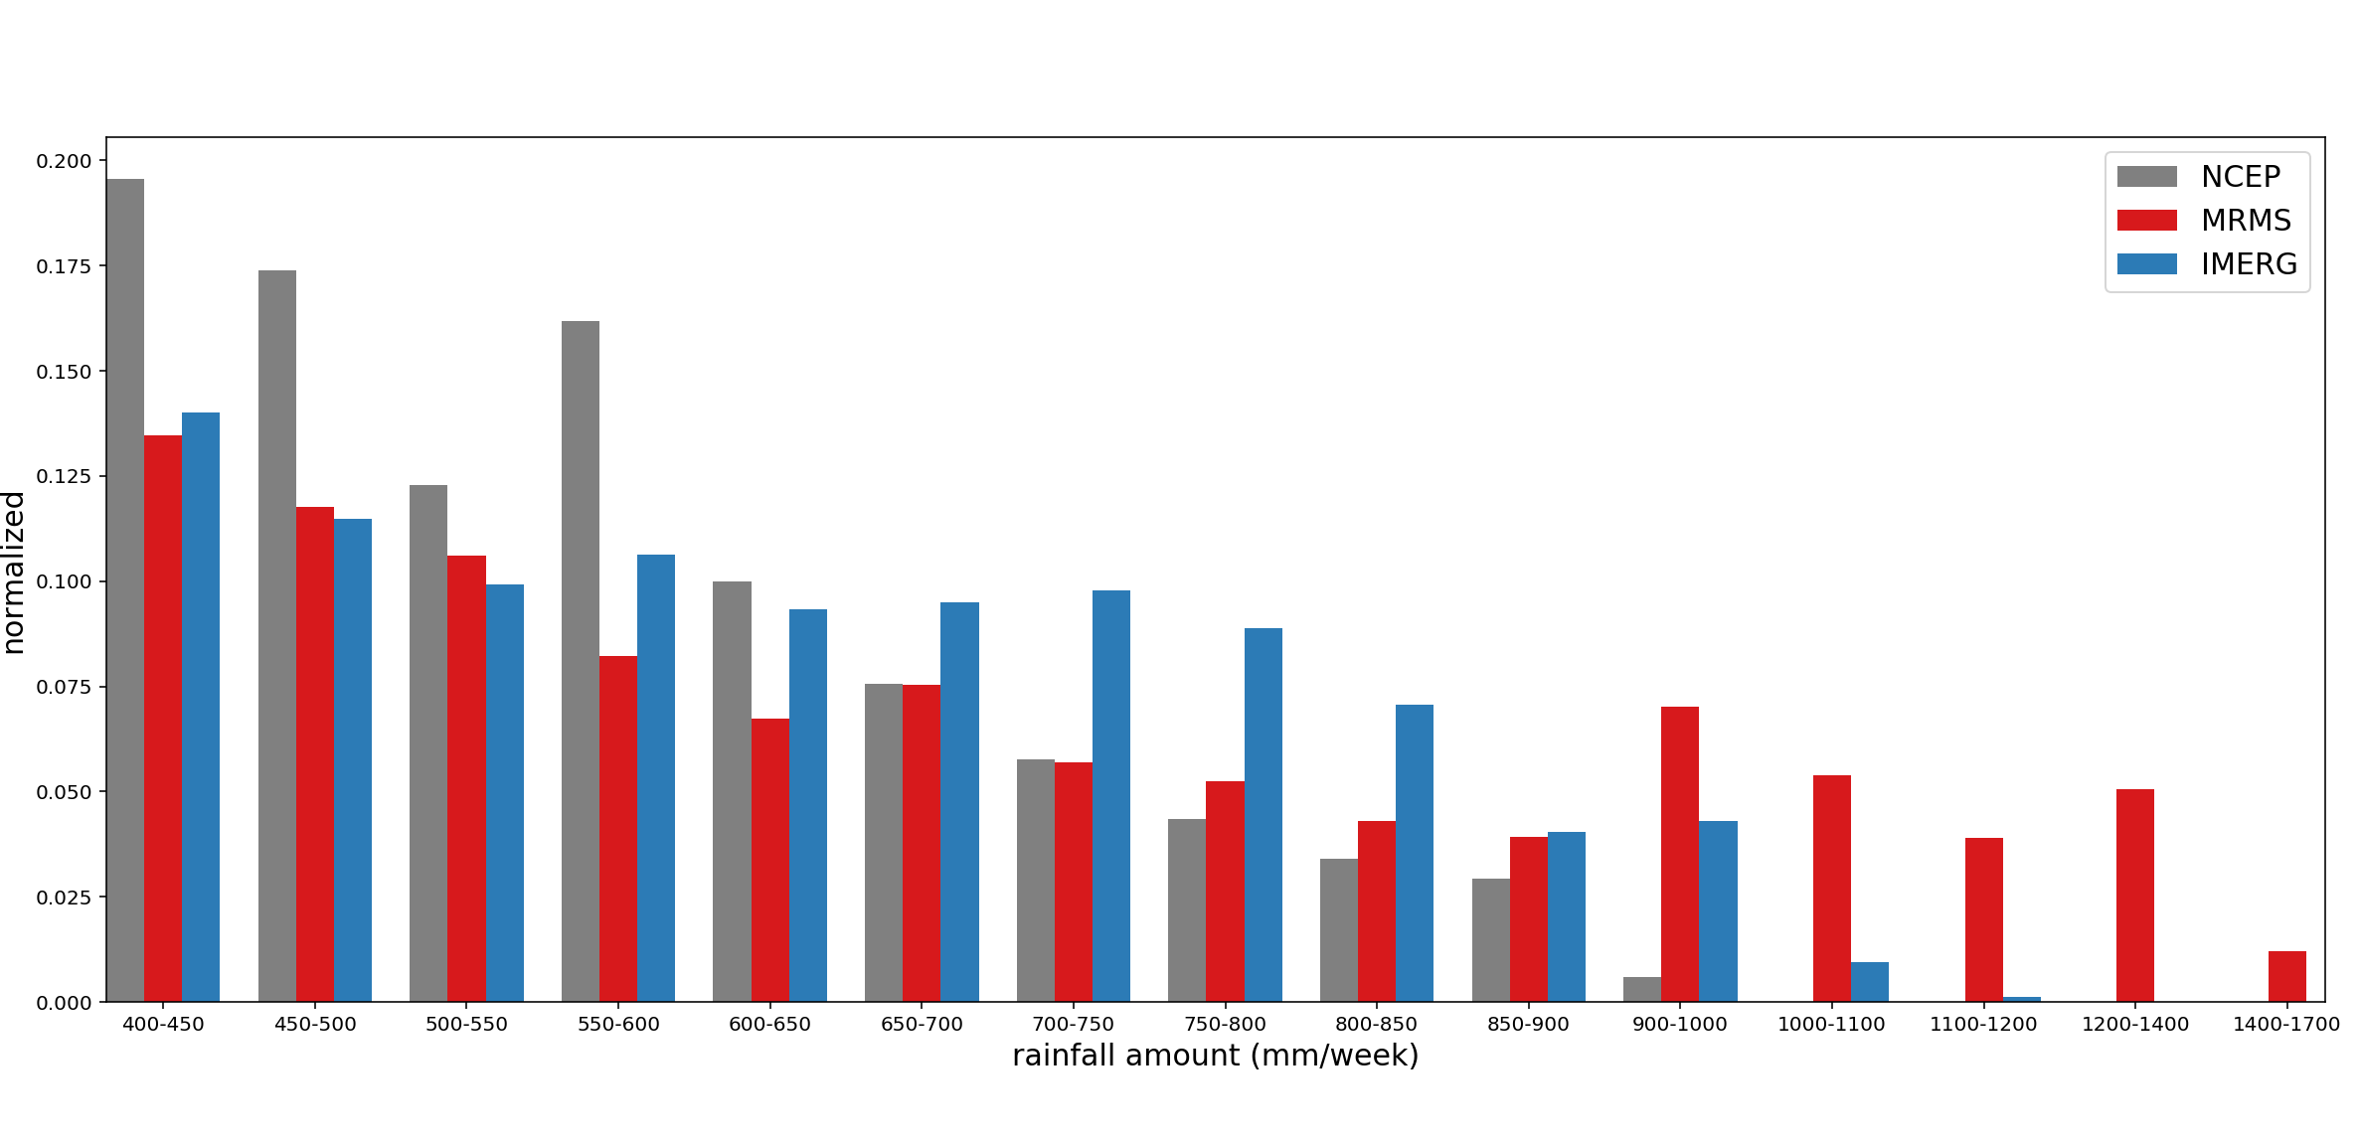
Figure 7 histogram of accumulative rainfall binned at 50 mm interval from 400 mm (core) to 1700 mm. Vertical axis is the normalized samples.

Slide 8
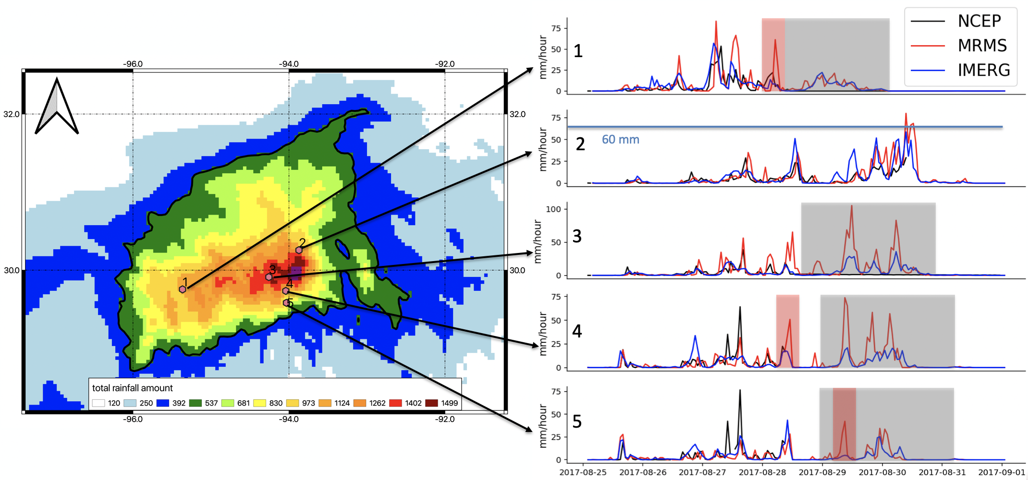
Figure 8 Core separated plot with selected pixel-wise time series. The black thick line is the 400 mm accumulated rainfall contour line to separate Harvey core regions. The windows in the right pane highlight special characteristics, with black corresponds to NCEP observation, red for MRMS and blue for IMERG.

Slide 9
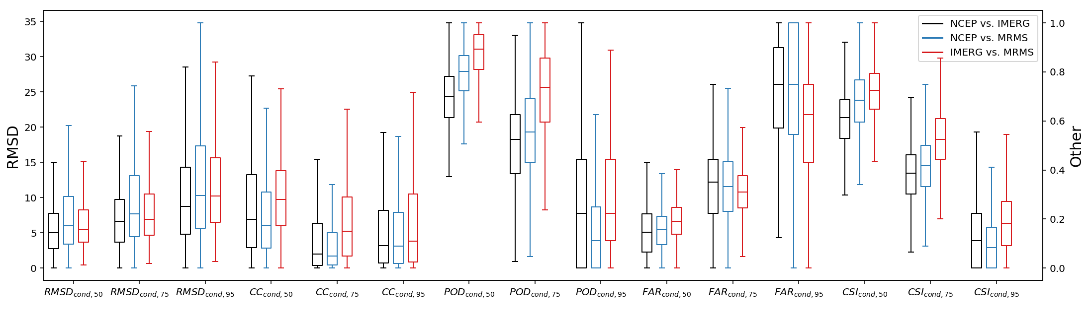
Figure 9 boxplot of metrics conditioned at 50, 75 and 95 percentiles in the core region. RMS difference corresponds to the left y-axis and all other metrics belong to the right y-axis ranging from 0 to 1.

Slide 10
Table 1 Events overview
hurricane/storm | start | end | duration | rainfall amount
Harvey | 25/8/17 | 31/8/17 | 7 days | 1625 mm
Bill | 16/6/15 | 18/6/15 | 3 days | 1451 mm
Cindy | 22/6/17 | 23/6/17 | 2 days
Imelda | 18/9/19 | 21/9/19 | 4 days

Slide 11
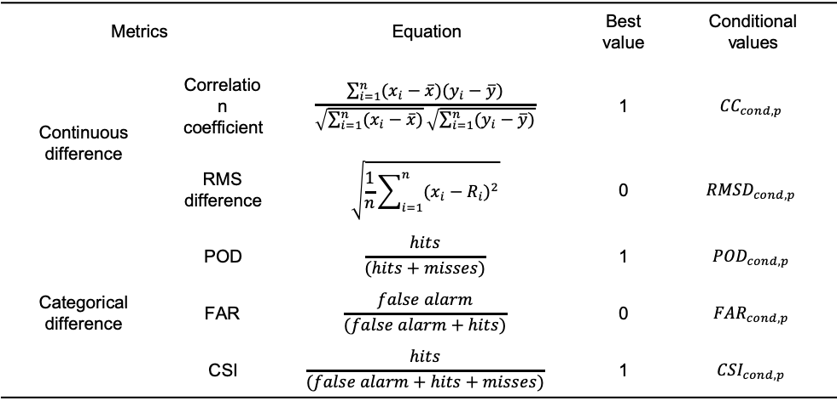
Table 1 metrics overview
Metrics |  | Equation | Best value | Conditional values
Continuous difference | Correlation coefficient | $$\frac{\sum_{i=1}^{n}{(x_{i}−\overline{x})(y_{i}−\overline{y})}}{\sqrt{\sum_{i=1}^{n}{(x_{i}−\overline{x})}}\sqrt{\sum_{i=1}^{n}{(y_{i}−\overline{y})}}}$$ | 1 | $${CC}_{cond,p}$$
 | RMS difference | $$\sqrt{\frac{1}{n}\sum_{i=1}^{n}{{(x_{i}−R_{i})}^{2}}}$$ | 0 | $${RMSD}_{cond,p}$$
Categorical difference | POD | $$\frac{hits}{(hits+misses)}$$ | 1 | $${POD}_{cond,p}$$
 | FAR | $$\frac{false alarm}{(false alarm+hits)}$$ | 0 | $${FAR}_{cond,p}$$
 | CSI | $$\frac{hits}{(false alarm+hits+misses)}$$ | 1 | $${CSI}_{cond,p}$$
Note: $x_{i}$, $y_{i}$ represent two evaluated products, with their associated mean values $\overline{x}$ and $\overline{y}$. For categorical difference, hits is defined by both evaluated value and reference value larger than threshold. False alarm is evaluated value larger than threshold but reference less than it. Misses are evaluated values less than threshold while reference larger than it. Conditional metrics are defined by given source data larger than a threshold i.e. p percentile of the daily rainfall for extreme events.

Slide 12
Metrics |  |  | NCEP/MRMS | NCEP/IMERG | IMERG/MRMS
Continuous difference | CC | 25th percentile | 0.271 | 0.299 | 0.512
 |  | 50th percentile | 0.421 | 0.444 | 0.622
 |  | 75th percentile | 0.559 | 0.585 | 0.717
 | RMS difference | 25th percentile | 0.906 | 0.774 | 0.790
 |  | 50th percentile | 1.338 | 1.169 | 1.176
 |  | 75th percentile | 2.107 | 1.844 | 1.844
Categorical difference | POD | 25th percentile | 0.333 | 0.426 | 0.574
 |  | 50th percentile | 0.600 | 0.556 | 0.680
 |  | 75th percentile | 0.758 | 0.680 | 0.816
 | FAR | 25th percentile | 0.186 | 0.296 | 0.126
 |  | 50th percentile | 0.326 | 0.452 | 0.280
 |  | 75th percentile | 0.5 | 0.571 | 0.448
 | CSI | 25th percentile | 0.333 | 0.280 | 0.395
 |  | 50th percentile | 0.434 | 0.363 | 0.484
 |  | 75th percentile | 0.556 | 0.5 | 0.593
Table 3 overview of inter-comparison between three products. Metrics e.g. CC, RMSD, POD, FAR, CSI are categorized by three percentiles. Highlighted cells are the best performance within each context.

